Slide 1
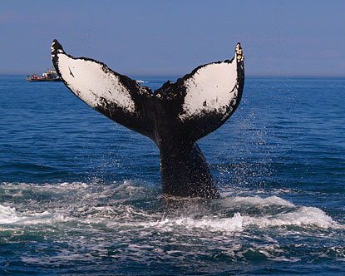
Marine Mammals, The Navy, and Sonar
Jackie Rainer

Slide 2
The Issue
SONAR is dangerous to the health and well-being of marine mammals. The Navy should refrain from using it where mammals are known to congregate.

Slide 3
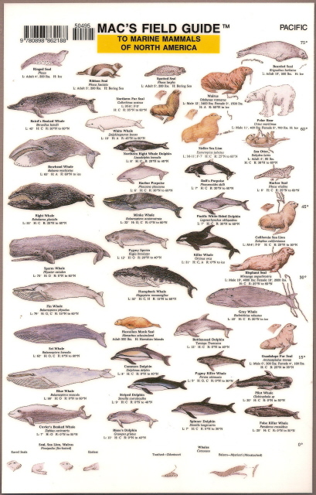
Marine Mammals
128 species
4 groups
Rely on ocean for existence
Important to ecosystem
23% threatened

Slide 4
Echolocation
Odoncetes
Allows them to “see”
Transmits sound and reflects back
Sound conducting tissue
Hunting and navigation
From air spaces or sinuses
To oil-filled channels
Low-frequency echos
(Julianna’s Review)

Slide 5
Communication
Clicks
Groans
Whistles
Other noises

Slide 6
The Navy
Mission: to maintain, train and equip combat-ready Naval forces capable of winning wars, deterring aggression and maintaining freedom of the seas.

Slide 7
“From everyday small feats to undeniably heroic efforts, the accomplishments and achievements of America’s Navy are vast and significant. Since its birth on October 13, 1775, the Navy has been involved with more than ten major wars and countless battles in the effort to bring security, democracy and prosperity to the American people and to the international community.”
~Navy.com

Slide 8
Submarines
Naval equipment
Element of surprise
Submerged and undetectable
Blind travel
Periscopes
RADAR
SONAR
NBCNews.com

Slide 9
SONAR
This system uses sound waves that travel through the water in search of objects or geographical obstacles.

Slide 10
SONAR Sound Navigation and Ranging
Passive
Active
History.navy.military

Slide 11
Echolocation and SONAR

Slide 12
SONAR’s effects
Confuse
Injure
Ear damage
Tissue damage
Interference
Kill

Slide 13
Mass Stranding's

Slide 14
National Security

Slide 15
“We don’t have to choose between national security and protecting the environment.” – Michael Jasny, NRDC senior policy analyst

Slide 16
Common sense safety measures from the NDRC for the Navy
Refrain from using sonar within 12 nautical miles of the California coast and in certain vulnerable whale habitats.
Stop using sonar when marine mammals are spotted within 2,200 yards of a sonar-emitting vessel.
Power down sonar by 6 decibels during “surface ducting” conditions. (Surface ducts are areas in the water where sound waves can be channeled, resulting in more intense exposure for whales.)
Keep a watch out for whales from the air and delay exercises when they’re within range.
From: NDRC

Slide 17
MMO
Marine Mammals Observer
Rules for SONAR usage

Slide 18
Alternatives
Passive SONAR
Magnetic sensor
Thermal imaging

Slide 19
Until then…

Slide 20
Works Cited
Bland, E. (n.d.). Cloak of silence. Retrieved from
http://www.msnbc.msn.com/id/31369750/ns/technology_and_science-science
/t/cloak-silence-tech-could-hide-submarines/
The jokes on you. (n.d.). Retrieved from
http://www.news-record.com/blog/52940/entry/94847
Protecting whales from dangerous sonar. (n.d.). Retrieved from
http://www.nrdc.org/wildlife/marine/protectingwhales.asp
The stress response of killer whales. (n.d.). Retrieved from
http://genefish.wikispaces.com/Juliana's Review
Whales, dolphins and sound. (n.d.). Retrieved from
http://www.environment.gov.au/coasts/species/cetaceans/sound.html

Slide 21
Effects of sonar. (n.d.). Retrieved from
http://www.marineconnection.org/campaigns/sonar_sonar.html
Elements of submarine operation. (n.d.). Retrieved from
http://www.history.navy.mil/branches/teach/dive/elem.htm
Fuentes, G. (2008). Navy loses court battle over sonar use. Navy Times, , 12-12. Retrieved from http://search.proquest.com/docview/203957765?accountid=10919
Marine mammal. (n.d.). Retrieved from http://en.wikipedia.org/wiki/Marine_mammal
Mission and history. (n.d.). Retrieved from http://www.navy.com/about/mission.html
National marine mammal laboratory. (n.d.). Retrieved from
http://www.afsc.noaa.gov/nmml/education/cetaceans/cetaceaechol.php
Protecting whales from dangerous sonar. (n.d.). Retrieved from http://www.nrdc.org/wildlife/marine/protectingwhales.asp
Rawlins, W. (2008, Nov 17). Ruling favors navy range: Plans for submarine sonar training get a
boost, despite risk for marine mammals. McClatchy - Tribune Business News. Retrieved from http://search.proquest.com/docview/456762679?accountid=10919
Slocum, J. (n.d.). Does military sonar kill marine mammals?. Retrieved from
http://www.scientificamerican.com/article.cfm?id=does-military-sonar-kill

